Slide 1
CAPSTONE PROJECT
Credit Card Default Prediction

Slide 2
CONTENT
BUSINESS UNDERSTANDING
DATA SUMMARY
FEATURE ANALYSIS
EXPLORATORY DATA ANALYSIS
DATA PREPROCESSING
IMPLEMENTING ALGORITHMS
CHALLENGES
CONCLUSIONS

Slide 3
BUSINESS UNDERSTANDING
In today’s world credit cards have become a lifeline to a lot of people so banks provide us with credit cards. Now we know the most common issue there is in providing these kind of deals are people not being able to pay the bills. These people are what we call “defaulters”.
Credit card default happens when you have become severely delinquent on your credit card payments.Missing credit card payments once or twice does not count as a default. A payment default occurs when you fail to pay the Minimum Amount Due on the credit card for a few consecutive months
Objective of our project is to predict which customer might default in upcoming months.
The research aims at developing a mechanism to predict the credit card default beforehand and to identify the potential customer base that can be offered various credit instruments so as to invite minimum default.

Slide 4
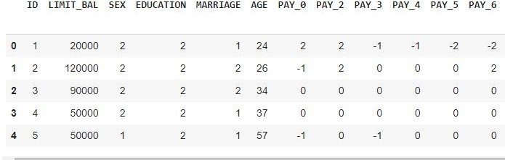
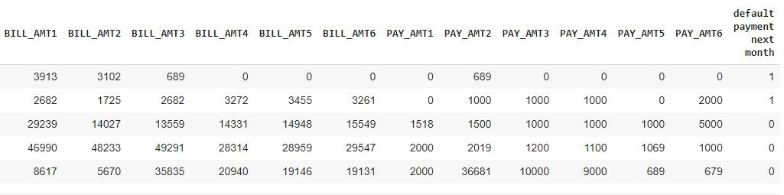
DATA SUMMARY

Slide 5
FEATURE SUMMARY
X1 -Amount of credit(includes individual as well as family credit)
X2 -Gender
X3 -Education
X4 -Marital Status
X5 -Age
X6 to X11 -History of past payments from April to September
X12 to X17 -Amount of bill statement from April to September
X18 to X23 -Amount of previous payment from April to September
Y -Default payment

Slide 6
INSIGHTS FROM OUR DATASET
This Dataset is from Taiwan.
In our data set there are 30000 rows, 26 columns
There are No Missing Values present
There are No Duplicate values present
There are No null values.
And ﬁnally we have 'default payment next month' variable which we need to predict for new observations
9 Categorical variables present.
6 Months payment and bill data available.
The Columns are: - 'ID', 'LIMIT_BAL', 'SEX', 'EDUCATION', 'MARRIAGE', 'AGE', 'PAY_0', 'PAY_2', 'PAY_3', 'PAY_4', 'PAY_5', 'PAY_6', 'BILL_AMT1', 'BILL_AMT2', 'BILL_AMT3', 'BILL_AMT4', 'BILL_AMT5', 'BILL_AMT6', 'PAY_AMT1', 'PAY_AMT2', 'PAY_AMT3', 'PAY_AMT4', 'PAY_AMT5', 'PAY_AMT6', 'defaulters', 'AGE_BIN'

Slide 7
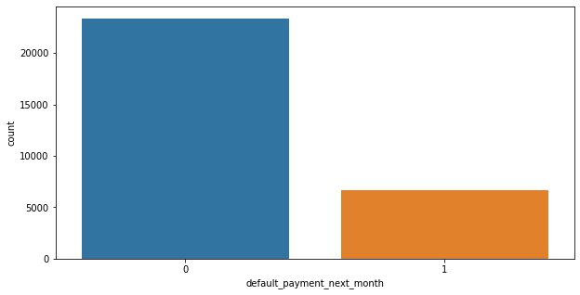
ANALYSIS OF DEPENDENT VARIABLE
As we can see from above graph that both classes are not in proportion and we have imbalanced dataset. we need to do normalize the data in next step.
0 23364
1 6636
0 - Not Default
1 - Default

Slide 8
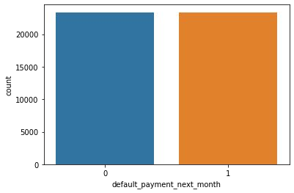
SMOTE
SMOTE (Synthetic Minority Oversampling Technique) – Oversampling is one of the most commonly used oversampling methods to solve the imbalance problem. It aims to balance class distribution by randomly increasing minority class examples by replicating them.
After performing SMOTE operation we get this balance dataset

Slide 9
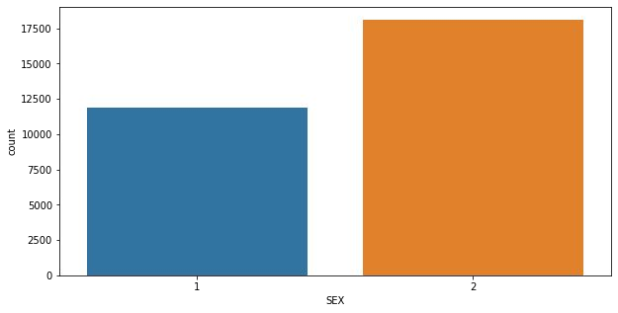
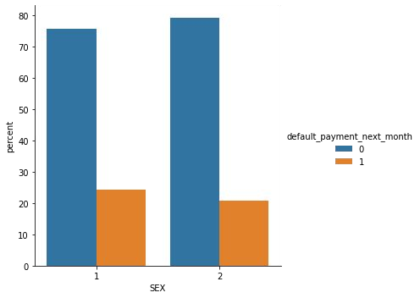
ANALYSIS OF SEX VARIABLE
1 - Male 2 - Female
Number of Male credit holder is less than Female.
It is evident from the above graph that the number of defaulter have high proportion of males

Slide 10
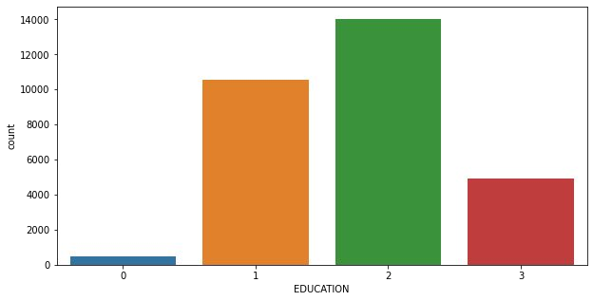
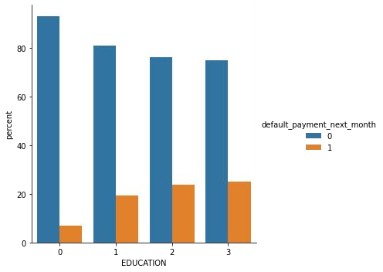
ANALYSIS OF EDUCATION VARIABLE
1=graduate school, 2=university, 3=high school, 0=others
From the above left side plot we can say that
More number of credit holders are university students followed by Graduates and then High school students.
From the right side plot it is clear that those people who are other students have higher default payment wrt graduates and university people

Slide 11
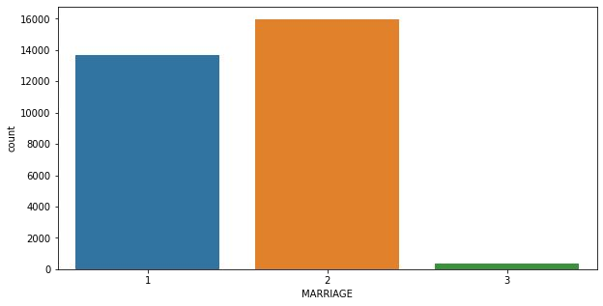
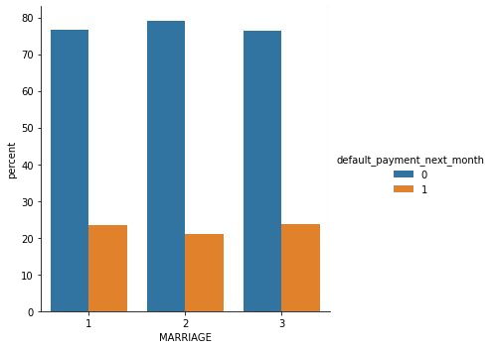
ANALYSIS OF MARRIAGE VARIABLE
1 - married 2 - single 3 - others
From the above data analysis we can say that
More number of credit cards holder are Single.
High defaulter rate when it comes to others

Slide 12
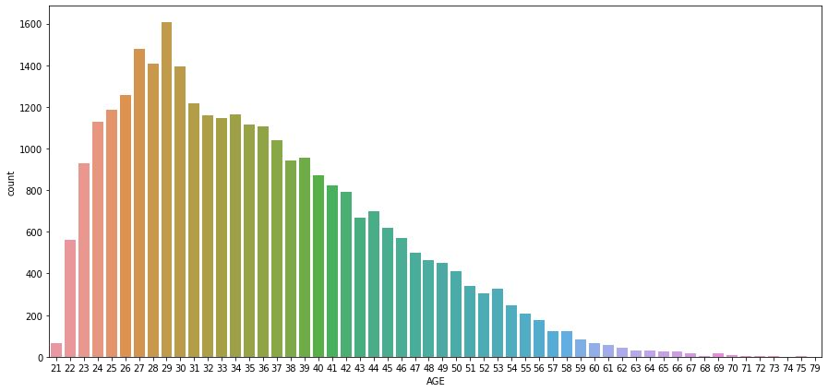
ANALYSIS OF AGE VARIABLE
From the above count plot analysis we can say that
We can see more number of credit cards holder age are between 26-30 years old.
Age above 60 years old rarely uses the credit card.

Slide 13
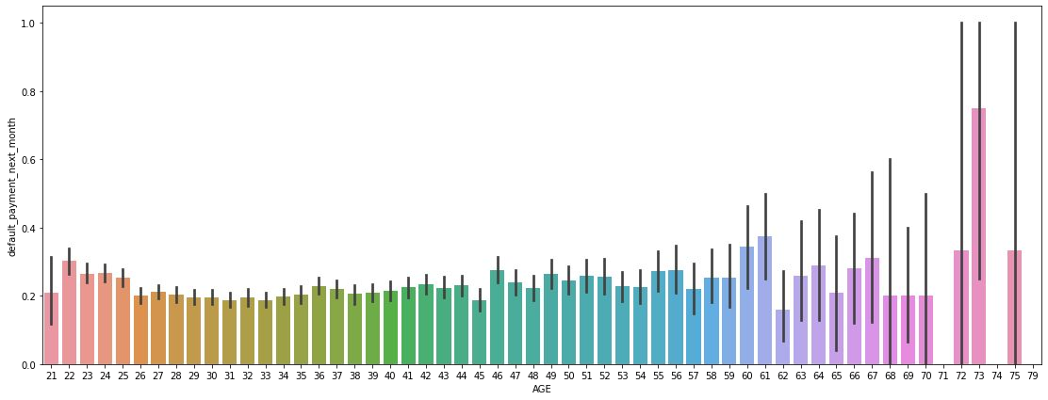
ANALYSIS OF AGE VARIABLE
From the above bar plot which shows the relationship between age and defaulter, we can say that
Those who default are 60 years and older, that may be they don’t use their card frequently

Slide 14
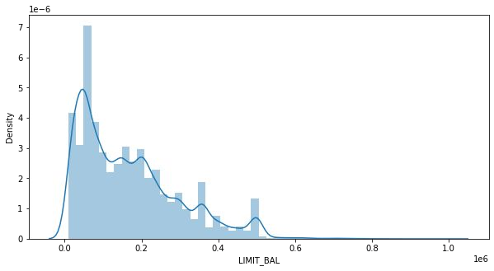
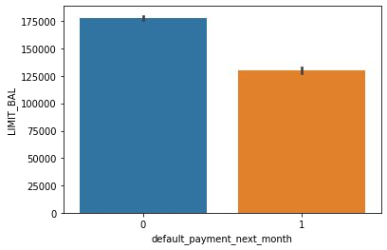
ANALYSIS OF LIMIT BALANCE VARIABLE
From the above plots analysis we can say that
Maximum amount of given credit in NT dollars is 50,000 followed by 30,000 and 20,000.

Slide 15
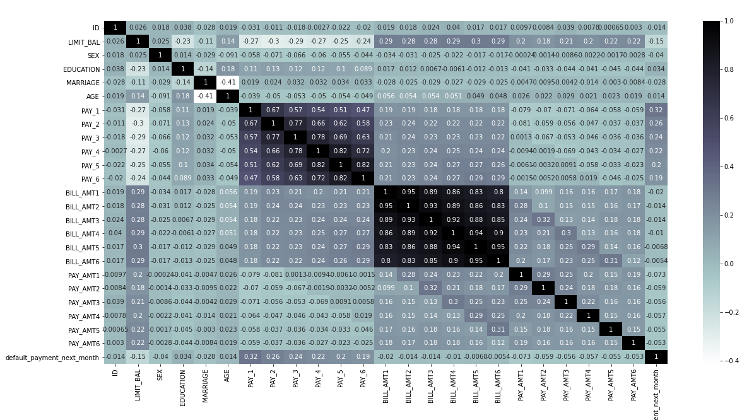
CHECKING OF CORRELATION

Slide 16
ONE HOT ENCODING
One hot encoding is a process by which categorical variables are converted into a form that could be provided to ML algorithms to do a better job in prediction.
here we perform one hot encoding on 'EDUCATION','MARRIAGE','PAY_SEPT', 'PAY_AUG', 'PAY_JUL', 'PAY_JUN', 'PAY_MAY', 'PAY_APR'
and label encoding for ‘SEX’
After this we get these features in our dataset:
(['LIMIT_BAL', 'SEX', 'AGE', 'BILL_AMT_SEPT', 'BILL_AMT_AUG', 'BILL_AMT_JUL', 'BILL_AMT_JUN', 'BILL_AMT_MAY', 'BILL_AMT_APR', 'PAY_AMT_SEPT', 'PAY_AMT_AUG', 'PAY_AMT_JUL', 'PAY_AMT_JUN', 'PAY_AMT_MAY', 'PAY_AMT_APR', 'default_payment', 'EDUCATION_graduate school', 'EDUCATION_high school', 'EDUCATION_others', 'EDUCATION_university', 'MARRIAGE_married', 'MARRIAGE_other', 'MARRIAGE_single', 'PAY_SEPT_-1', 'PAY_SEPT_0', 'PAY_SEPT_1', 'PAY_SEPT_2', 'PAY_SEPT_3', 'PAY_SEPT_4', 'PAY_SEPT_5', 'PAY_SEPT_6', 'PAY_SEPT_7', 'PAY_SEPT_8', 'PAY_AUG_-1', 'PAY_AUG_0', 'PAY_AUG_1', 'PAY_AUG_2', 'PAY_AUG_3', 'PAY_AUG_4', 'PAY_AUG_5', 'PAY_AUG_6', 'PAY_AUG_7', 'PAY_AUG_8', 'PAY_JUL_-1', 'PAY_JUL_0', 'PAY_JUL_1', 'PAY_JUL_2', 'PAY_JUL_3', 'PAY_JUL_4', 'PAY_JUL_5', 'PAY_JUL_6', 'PAY_JUL_7', 'PAY_JUL_8', 'PAY_JUN_-1', 'PAY_JUN_0', 'PAY_JUN_1', 'PAY_JUN_2', 'PAY_JUN_3', 'PAY_JUN_4', 'PAY_JUN_5', 'PAY_JUN_6', 'PAY_JUN_7', 'PAY_JUN_8', 'PAY_MAY_-1', 'PAY_MAY_0', 'PAY_MAY_1', 'PAY_MAY_2', 'PAY_MAY_3', 'PAY_MAY_4', 'PAY_MAY_5', 'PAY_MAY_6', 'PAY_MAY_7', 'PAY_MAY_8', 'PAY_APR_-1', 'PAY_APR_0', 'PAY_APR_1', 'PAY_APR_2', 'PAY_APR_3', 'PAY_APR_4', 'PAY_APR_5', 'PAY_APR_6', 'PAY_APR_7', 'PAY_APR_8'],

Slide 17
MODEL BUILDING
LOGISTIC REGRESSION
RANDOM FOREST
Decision Tree
XGBClassifier

Slide 18
LOGISTIC REGRESSION
from this regression model we get the results as below
The accuracy on test data is
0.7553984825886778
The precision on test data is
0.7964514539181863
The recall on test data is
0.6854234412554786
The f1 on test data is
0.7367781155015198
The roc_score on test data is
0.755522444578221
PARAMETERS :
{'C': 1, 'penalty': 'l2'}

Slide 19
RANDOM FOREST
from the regression model we get the results as below
The accuracy on test data is 0.8329909262112652
The precision on test data is 0.8588300424432552
The recall on test data is
0.7969178082191781
The f1 on test data is
0.8267164046540546
The roc_score on test data is 0.8329847514221532
PARAMETERS :
{'max_depth': 30,
'n_estimators': 250}

Slide 20
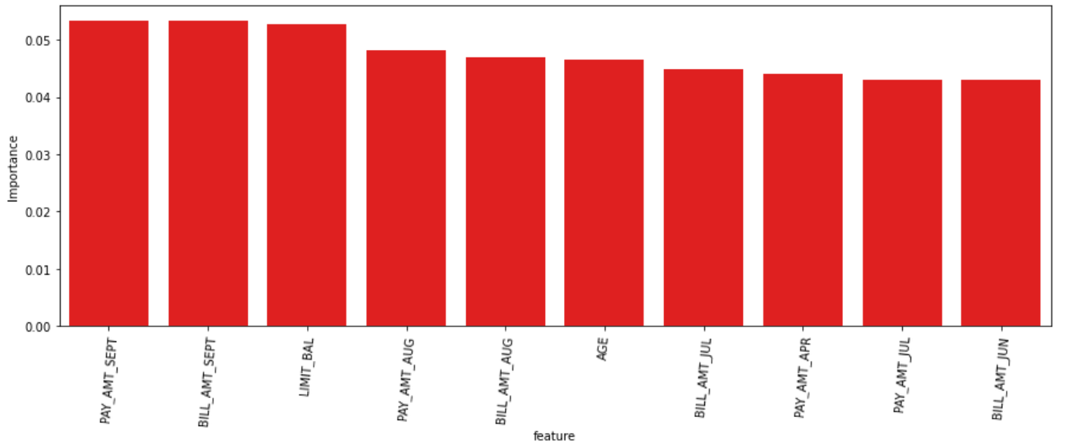
FEATURE IMPORTANCES

Slide 21
Decision Tree Classifier
from the regression model we get the results as below
The accuracy on test data is 0.7521828454031844
The precision on test data is 0.776877514570408
The recall on test data is 0.7075342465753425
The f1 on test data is
0.74056815112680348
The roc_score on test data is 0.7521752027125258
PARAMETERS :
{‘criterion’: entropy,
‘min_samples_split’: ‘100'}

Slide 22
XGBOOST
from the regression model we get the results as below
The accuracy on test data is 0.787562414888788
The precision on test data is 0.7316472114137483
The recall on test data is
0.8237441588785047
The f1 on test data is
0.7749690891605989
The roc_score on test data is 0.7912025355223038
PARAMETERS :
{‘max_depth’: 15
‘min_child_weight’: 8}

Slide 23
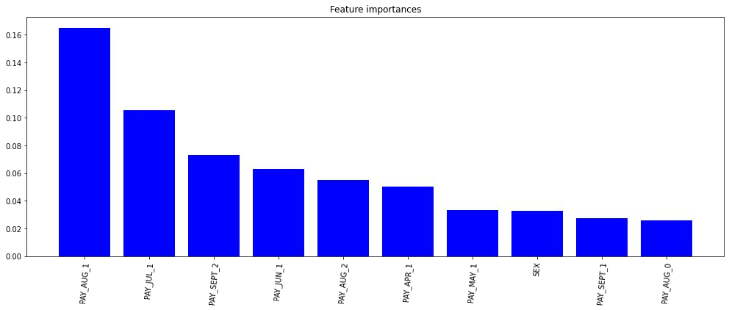
FEATURE IMPORTANCES

Slide 24
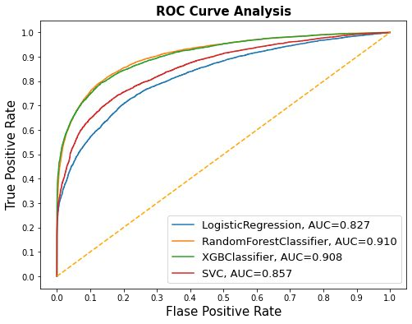
AUC-ROC CURVE COMPARISON

Slide 25
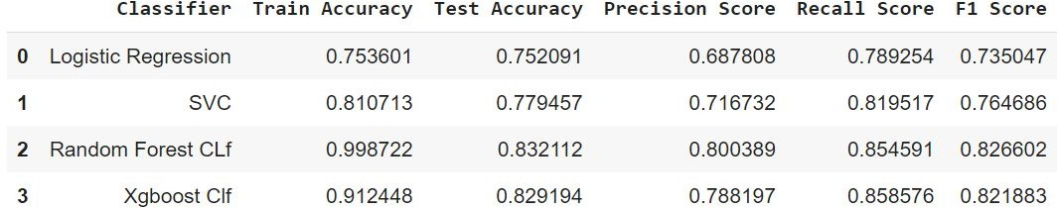
EVALUATING THE MODELS

Slide 26
CHALLENGES
Large dataset to handle
Feature Analysis
Need to Remove outliers
Feature engineering
Getting a higher accuracy on the models.
Carefully handled feature imbalanced data
Carefully tuned Hyperparameters .

Slide 27
CONCLUSION
Recent 2 months payment status and credit limit are the strongest default predictors.
Recall is the best accuracy metrics here, because if the algorithm will not detect the defaulters, that will encounter more loss to the bank
XGBoost provided us the best results giving us a recall of 85% percent(meaning out of 100 defaulters 85 will be correctly caught by XGBoost)
Random Forest also had good score as well but leads to overﬁt the data.
Logistic regression being the least accurate with a recall of 79%.
Higher recall can be achieved if low precision is acceptable.
This Model can only be served as an aid in decision making instead of replacing human decision.
Model can be improved with more data and computational resources.

Slide 28
Q & A

Slide 29
THANK YOU

